Slide 1
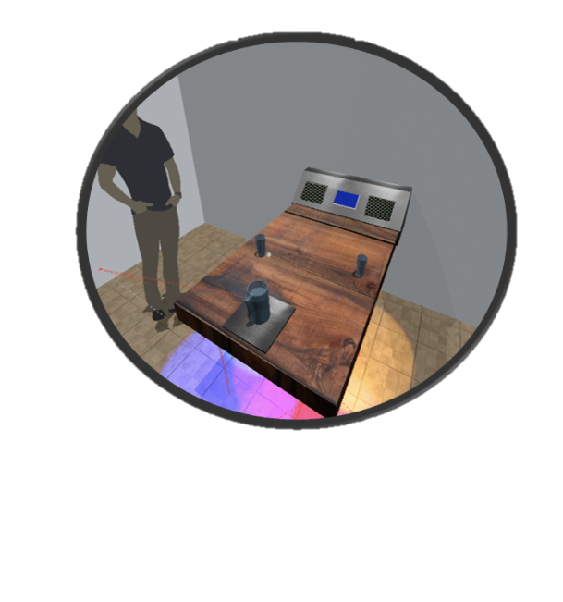
Smart Table
Group 16
Christopher Corley
Theodore Cox
Dhaval Desai
Mikey Garrity

Slide 2
Inspiration
Problem 1: Servers sometimes don’t notice when you’ve been seated until you’ve been sitting for a while
Problem 2: Flagging the waiter for help can be inconvenient, and can become frustrating for the customer
Problem 3: Waiters that don’t have line of sight won’t know if your drinks are low

Slide 3
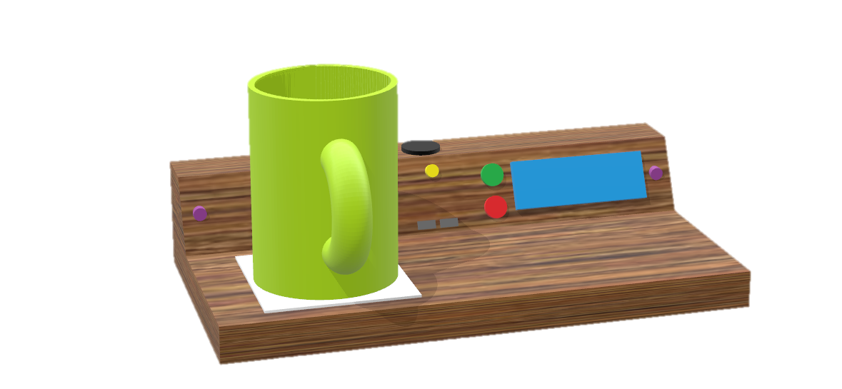
Solution
We propose a “Smart Table” that will integrate technology into the dining experience. Making the guest experience better, while making it easier for waiters to serve them. Our design includes three custom PCBs, an array of sensors, and a housing.
Notes:
More and more restaurants are making the move toward integrating smart technology into the dining experience. By integrating technology into restaurants, the guest experience can be enhanced, while giving restaurant staff more efficient tools to serve them. The smart table project bundles an array of sensors and electronics that will be placed as a kiosk on the end of a restaurant table. Its features include detection of the guests when they are seated, RGB mood lighting with adaptive brightness, a call server button via a restaurant staff mobile application, the ability to detect when your drinks are empty, and more. This project will be easily integrated into any restaurant and will be cost effective, opening the doors for restaurants around the world to introducing tech into the dining experience.

Slide 4
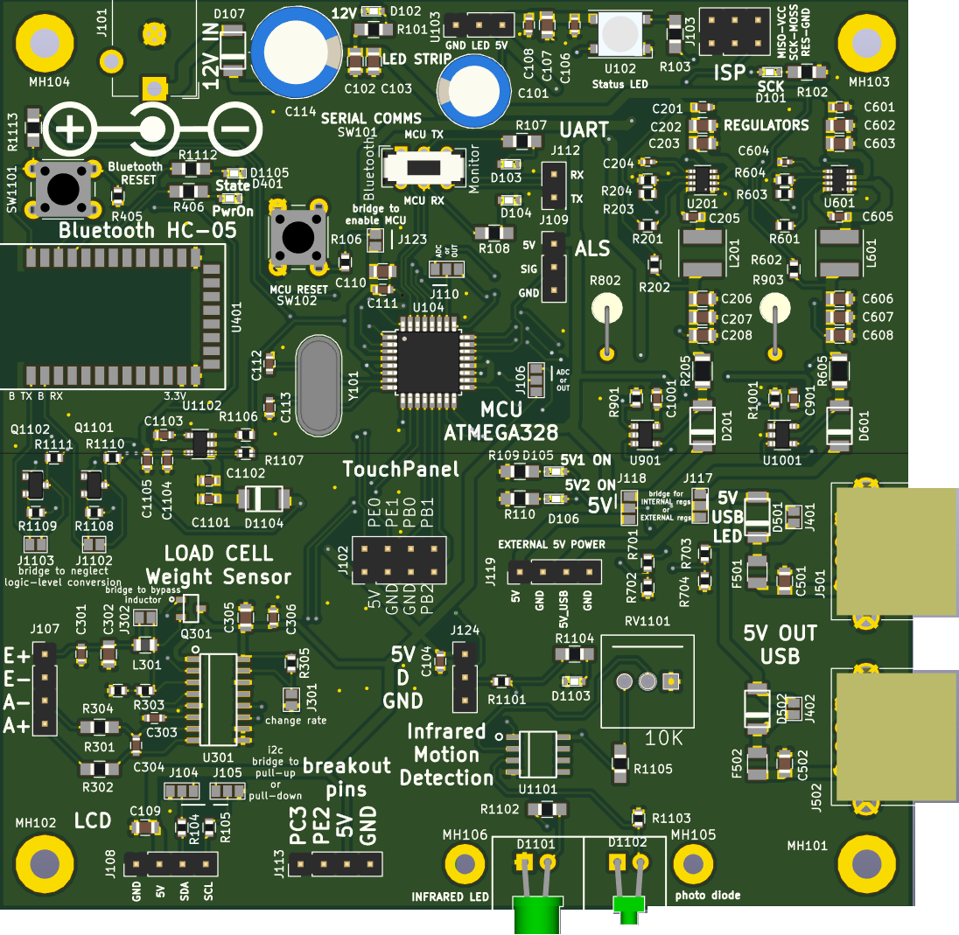
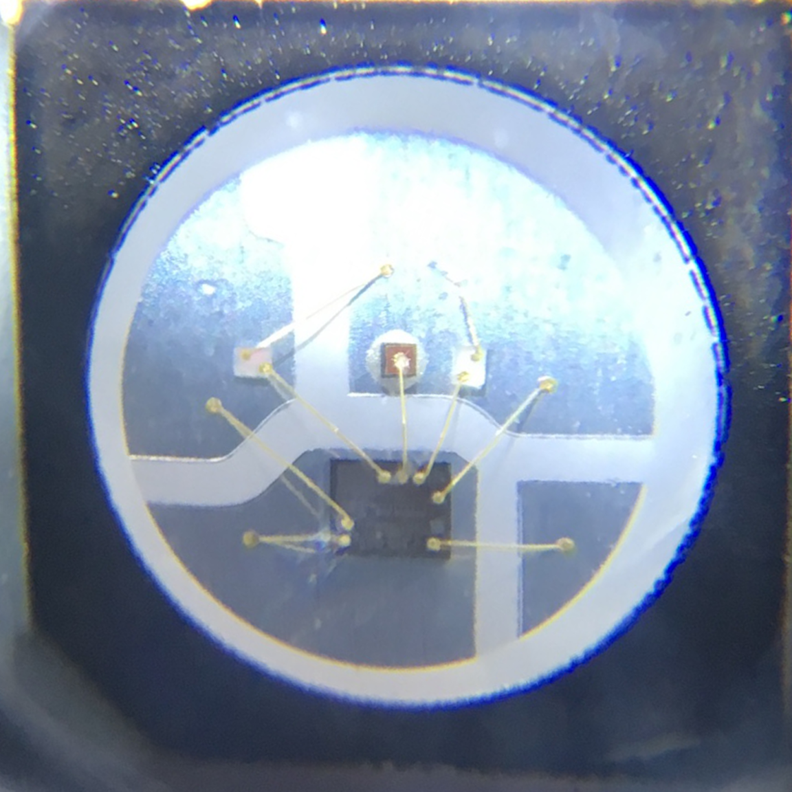
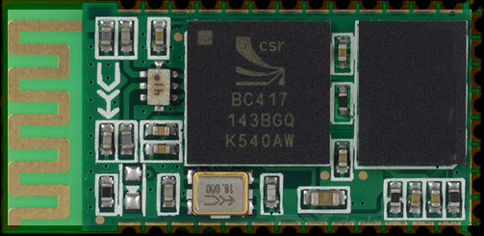
Technologies Integrated
We integrated:
IR sensor to detect when guest are seated
Ambient Light Sensor to modulate LED brightness
Bluetooth to send notifications to mobile application
Load Cell to track drink level
LEDs to allow servers to see a table’s status from distance
LCD Screen to display messages
USB Charging Ports for convenience
Notes:
More and more restaurants are making the move toward integrating smart technology into the dining experience. By integrating technology into restaurants, the guest experience can be enhanced, while giving restaurant staff more efficient tools to serve them. The smart table project bundles an array of sensors and electronics that will be placed as a kiosk on the end of a restaurant table. Its features include detection of the guests when they are seated, RGB mood lighting with adaptive brightness, a call server button via a restaurant staff mobile application, the ability to detect when your drinks are empty, and more. This project will be easily integrated into any restaurant and will be cost effective, opening the doors for restaurants around the world to introducing tech into the dining experience.

Slide 5
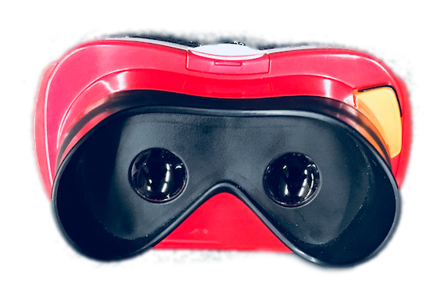
VR Development
Used virtual reality models to aid in development (Unity and Google Cardboard)
Philosophy: Measure twice, cut once
Helpful for construction / design decisions (Wire routing)
VR Demo available afterwards if interested

Slide 6
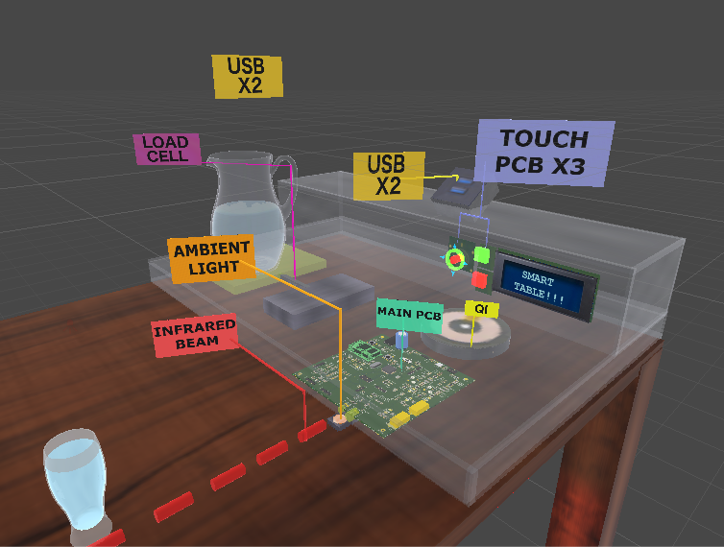
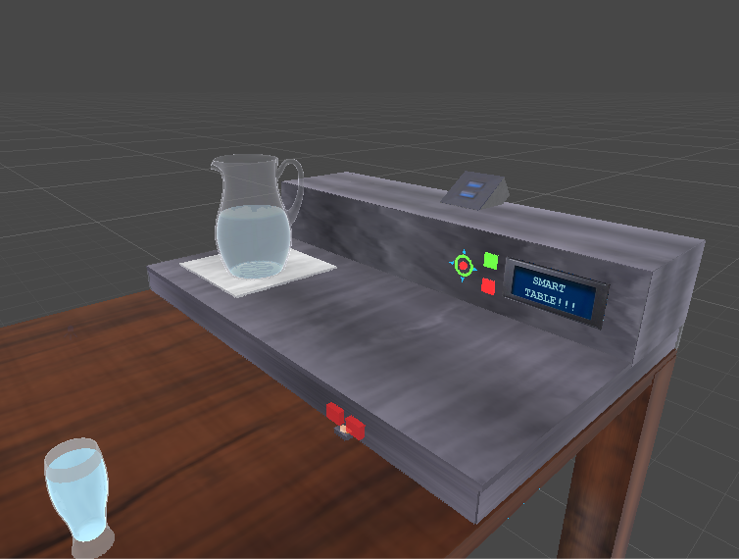
3D Render
Notes:
This is not a exact replica of the dimensions.

Slide 7
Requirements Specifications
The table’s lighting shall be illuminated in at least 2 distinct lighting patterns
The lighting brightness on the table shall be auto-adjustable based on 3 distinct brightness levels
The table’s smart LEDs shall emit at least 200 lux on the highest brightness setting
The table shall recognize when a server visits via a mobile application system within 10 seconds
The table shall communicate with the mobile application from a distance of at least 25 feet
The system shall use less than 25 watts of peak power
The printed circuit board design shall have regulators that support 5V and 3.3V sensors

Slide 8
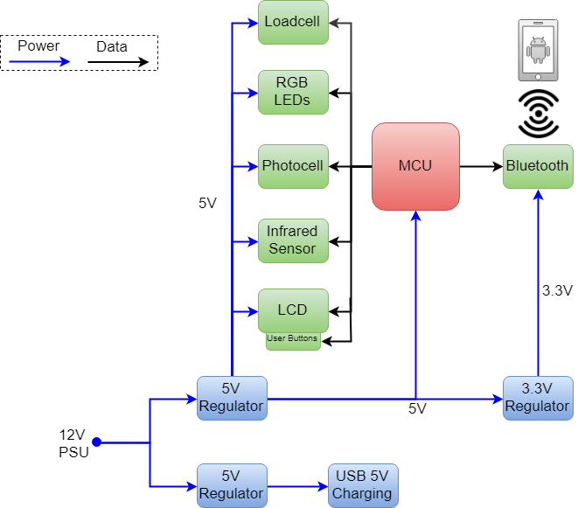
High Level System Block Diagram
Notes:
Need to update figure to reflect current design. ex: motion detection is on the PCB now

Slide 9
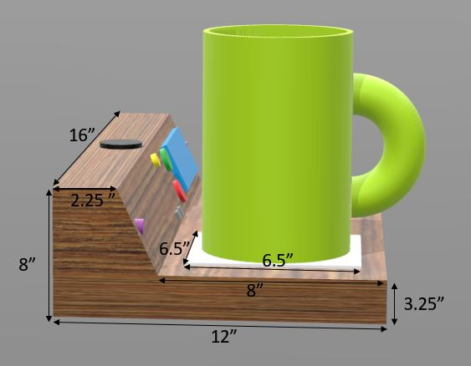
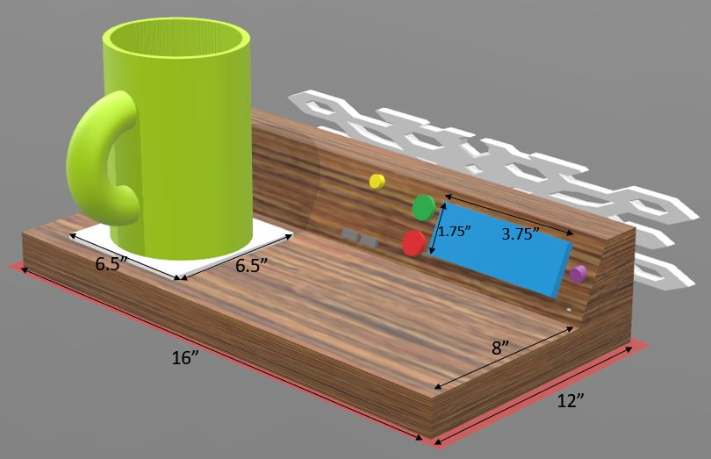
Dimensions
Designed the dimensions according to certain considerations:
Small enough to fit on any restaurant table
Will have room to facilitate an average size beverage pitcher
Minimizes dead space in the box

Slide 10
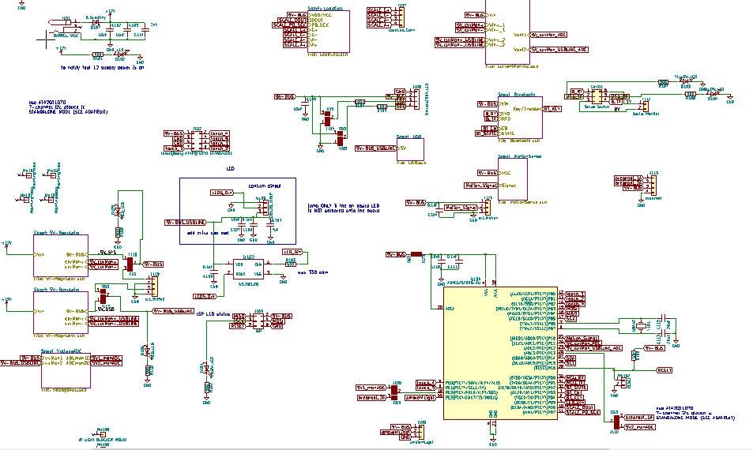
High Level Schematic Diagram
DM
Notes:
One sentence slide: “Here is an overview of the PCB schematic, we will be jumping into each subsystem in the following slides”

Slide 11
Subsystem Overview

Slide 12
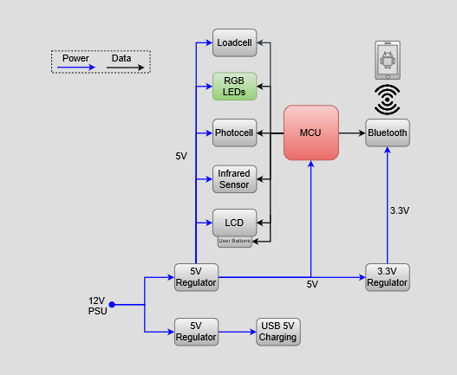
Smart LED Subsystem

Slide 13
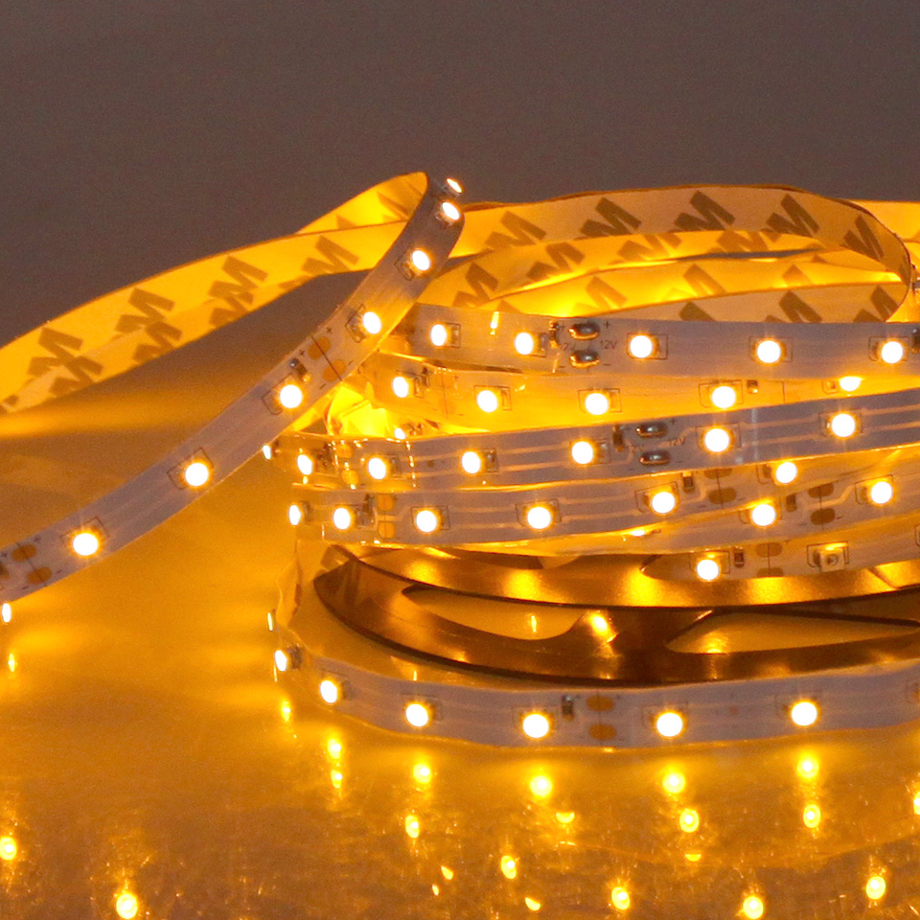
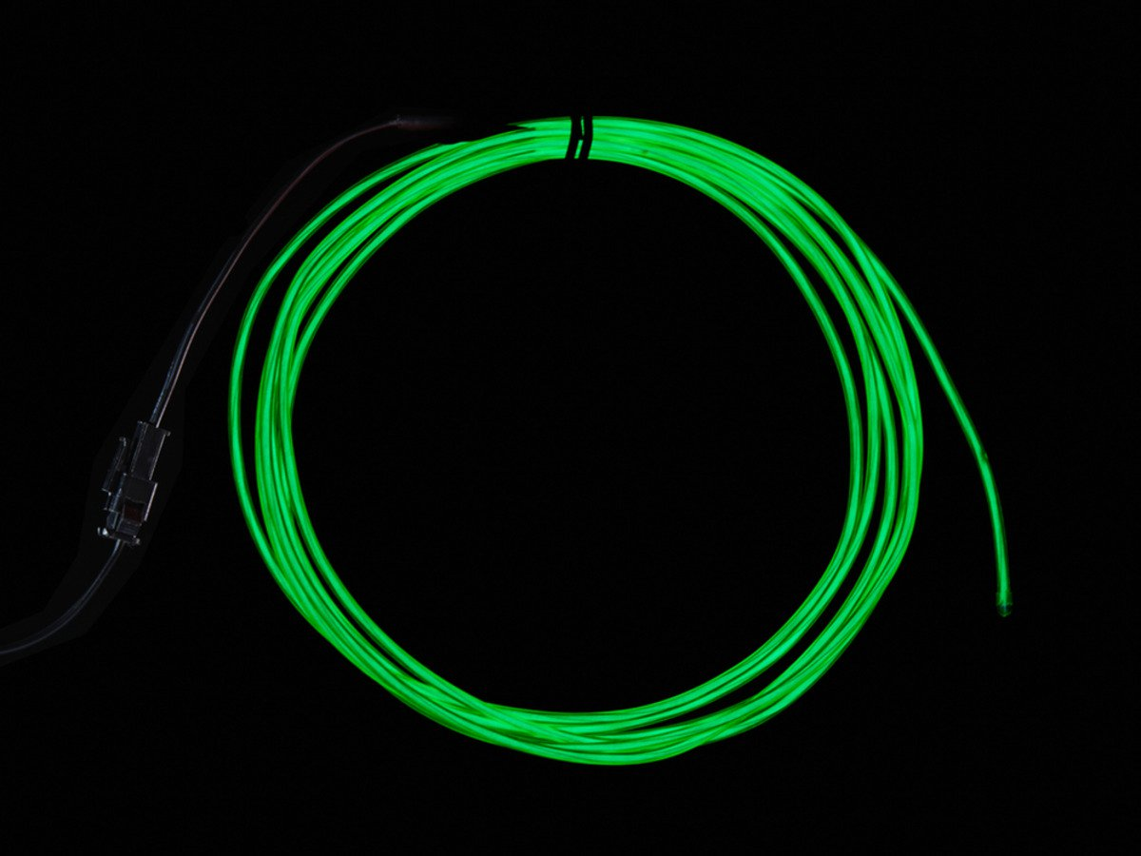
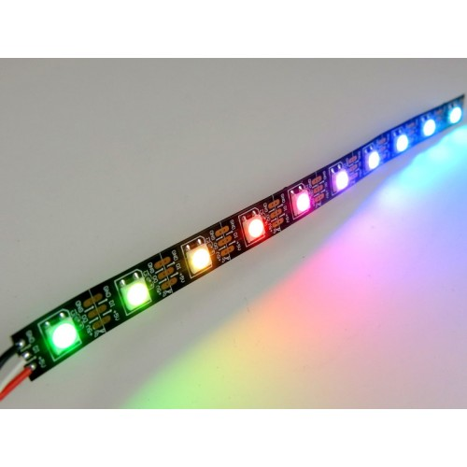
Smart LEDs
WS2812B LEDs: Best Choice
Used to Signal Waiters
Examples:
If guest needs immediate attention (Red)
When guests do not need assistance (Blue)
Provide ambient light
Used to welcome the guests when they are seated with a short light show

Slide 14
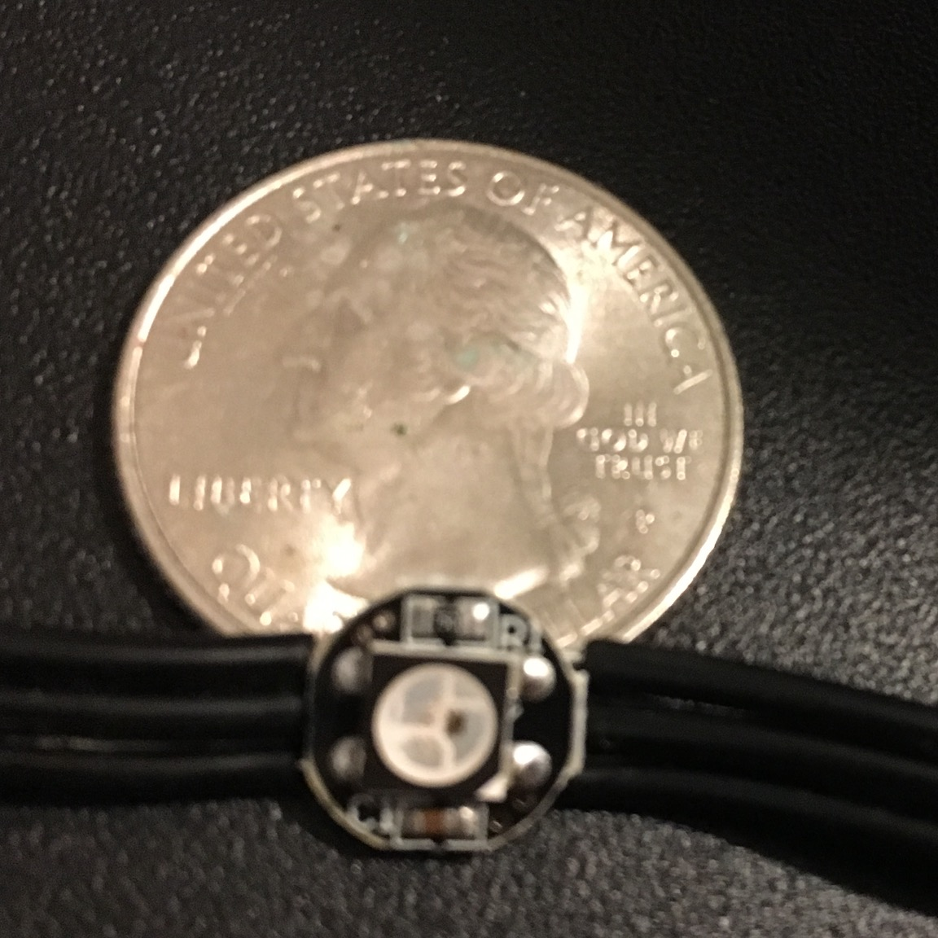
Smart LEDs
RGB LEDs
WS2812B: Modern 5V equivalent of addressable LEDs (12V)
1 Data Line - Internal Clock (Needs precise timing)
High Draw: 1-2 Amps Oscillating
IC (Clock)

Slide 15
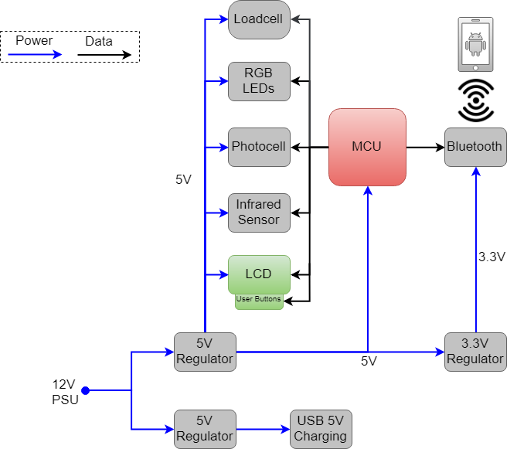
Information Display Subsystem
Notes:
Need to update figure to reflect current design. ex: motion detection is on the PCB now

Slide 16
Information Display PCB Topology

Slide 17
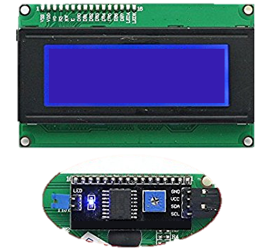
Information Display
Provides the ability to present text strings to the tables guests using the LCD screen
“Welcome! Your server will be with you shortly.”
Presents daily specials to the customers from the menu
Uses a custom designed capactive touch board to allow the guests to call for the server’s assistance
Smraza 2004 LCD Module
Welcome! Your server will be with you shortly.

Slide 18
Design Rationale: Which LCD Type?
Considered TFT LCD but needs more robust hardware to drive pixels
OLED looks nice but is more expensive, also life expectancy is lower
LED Matrix was too big and not high enough resolution
Realization that a simple character display was plenty adequate
 | TFT LCD | OLED | LED Matrix | Character LCD
Cost | $49.99 | $23.15 | $24.95 | $14.99
Pixel Resolution | 480x272 Pixels | 4x20 Characters | 16x32 LED Matrix | 4x20 Characters
Viewing Area | 4.3” Diagonal | 3” x 1” | 7.6” x 3.8” | 3” x 1”
Durability | Average | Low | Low | High
Life Expectancy | ~100,000 hr | ~14000 hr | ~50,000 hr | ~100,000 hr
Current Draw | ~65mA | ~55mA | 2.5A max | ~30mA
Operating Voltage | 3.3V Logic, 12V Backlight | 5V | 5V | 5V
Interface | DOT-CLK | 4-bit Parallel, 8-bit Parallel, SPI | 12 Digital Pins | I2C
Display Type | Pixel array | Segmented | Dot matrix array | Segmented
Viewing Angles | 6 o’clock | 175 degrees | 150 degrees | 150 degrees
Processing Overhead | High | Low | Medium | Low
Other Considerations | Touch Capabilities | Bright | Immersive | Economical

Slide 19
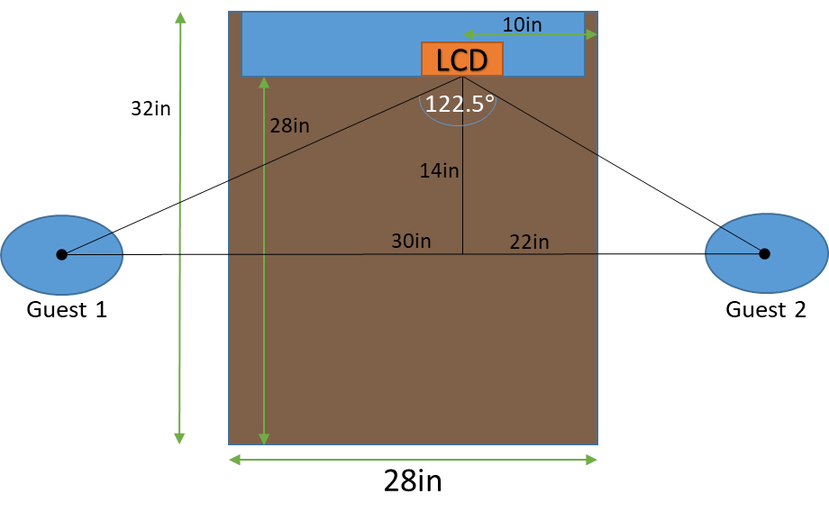
Viewing Angle Analysis
Some screen technology types have very poor viewing angles
Geometric analysis that shows the necessary viewing angles of the screen
122.5$°$ viewing angle or greater will be adequate for both guests to clearly see the text on the information display
MC

Slide 20
Capactive Touch Board Introduction
Designed a capactive touch PCB board
5 capacitive touch zones, powered by 5 respective touch logic boards
Allows users to interact with the smart table
Can be expanded to provide further user I/O in the future if desired
Reverse gull wing LEDs utilized: They allow the LED’s to emit through the back of the PCB

Slide 21
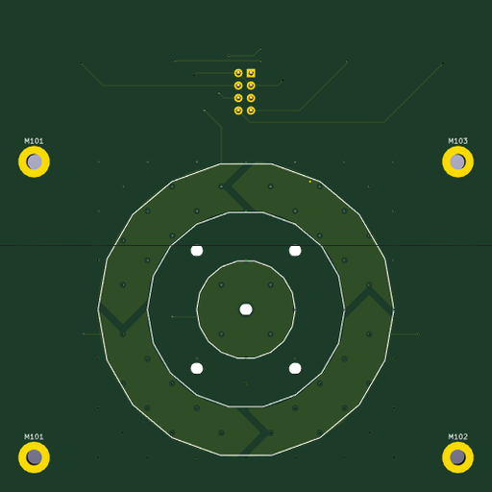
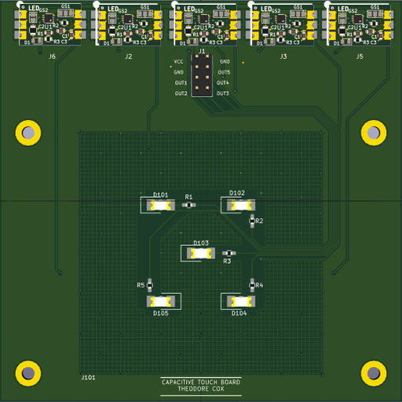
Capacitive Touch Panel Board PCB

Slide 22
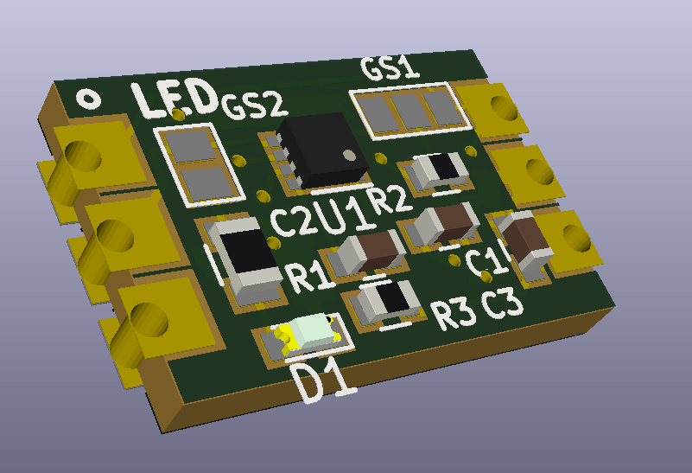
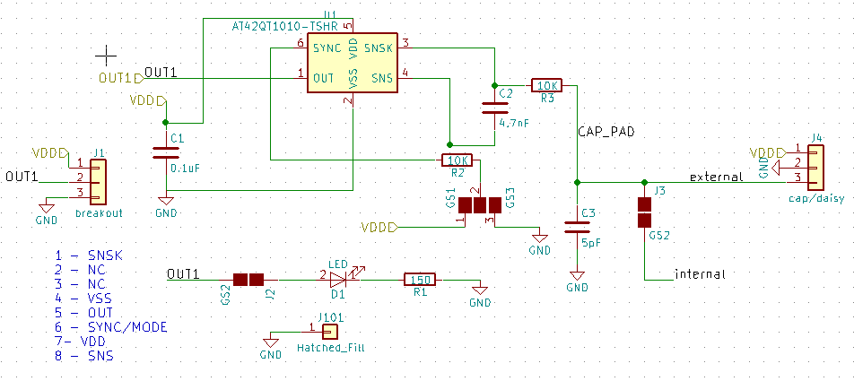
Capacitive Touch Driver Board Schematic
The capacitive touch panel board consists of 5 smaller driver boards (with castellated holes) custom designed using Microchip’s AT42QT1010-TSHR

Slide 23
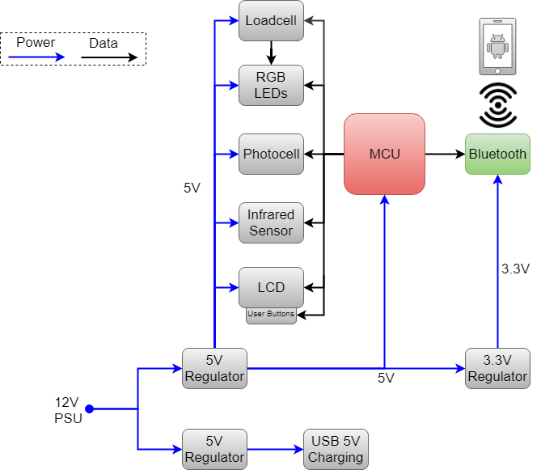
Bluetooth Subsystem

Slide 24
Waiter–Table Bluetooth Communication
Using HC-05 Bluetooth module for wireless communication
Works in tandem with the mobile application and other sensors to provide information to the server
Had to incorporate dedicated LDO regulator to drop from 5V to 3.3V for the Vcc on the Bluetooth module
Uses logic level shifter to drop logic voltage from 5V to 3.3V

Slide 25
Decisions: Bluetooth vs WiFi vs RFID
Don’t need range or throughput of Wi-Fi
Bluetooth is easy to interface within software
Selected Bluetooth v2.0 for legacy compatibility
RFID was considered but didn’t provide the functionally needed for a mobile server application
 | WiFi a/c | Bluetooth 2.0 | RFID
Cost | High | Low | Medium
Range | 200-800 ft | ~33 ft | Contact
Current Draw | ~80mA | 4uA (Low power mode), 140mA max | ~60mA
Operating Voltage | 3.3V | 3.3V | 3.3V
Security | Available | Available | N/A
Data Transfer Rate | Up to 866.7Mbps | 1Mbps | Up to 424 kbps
Latency | <1ms | 6ms | 1ms
Smartphone Application Development Needed | Yes | Yes | No

Slide 26
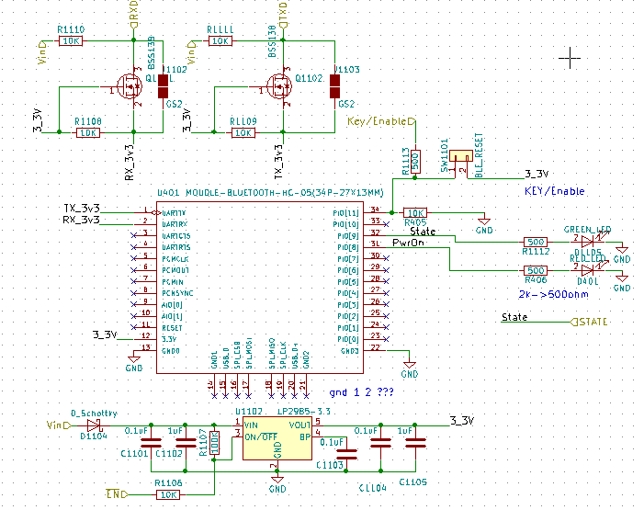
Bluetooth Schematic

Slide 27
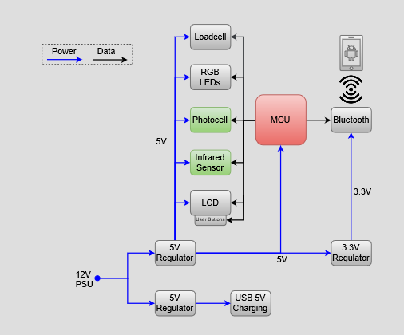
Motion Detection & Adaptive Brightness Subsystem
CT

Slide 28
Motion Detection with Infrared Sensor
Using an infrared emitter and receiver we will detect when guests are sitting at the table
When guests are seated according to sensor, the software routine will turn on the tables ambient lighting LEDs and notify the server that guests have arrived
If no movement is detect for a set period of time (2 mins) the lighting on the table will be turned off to save energy

Slide 29
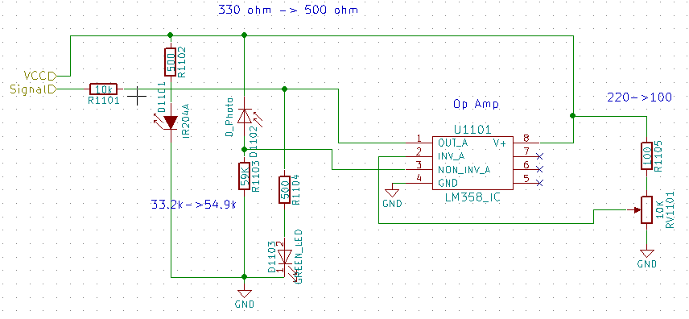
Infrared Sensor Schematic

Slide 30
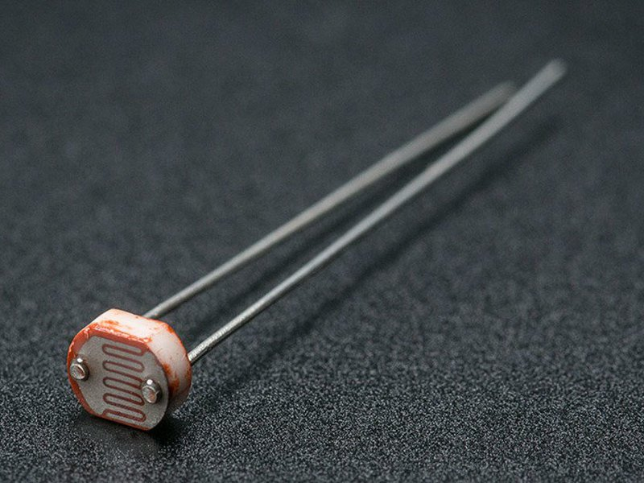
Photocell Sensor
Photocell sensor will determine how bright the area is around the table
This information will allow us to tweak the relative brightness of the signal LEDs intelligently
Tested the subsystem using photocell sensor designed by DF Robot (DFR0026) which can sense up to 6000 Lux in less than 15us.

Slide 31
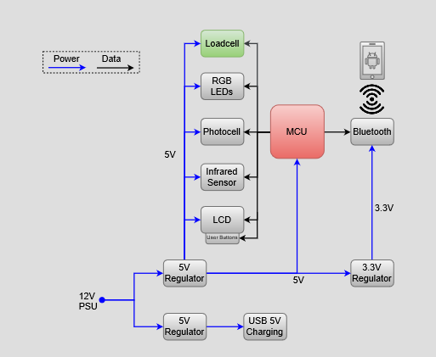
Loadcell / Beverage Tracking Subsystem

Slide 32
Loadcell PCB Topology

Slide 33
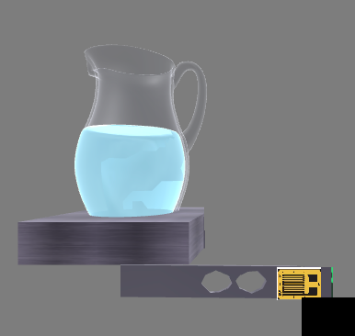
Beverage Tracking
Uses a loadcell and a amplification circuit to detect the weight of the beverage pitcher
Once the value reaches a certain threshold software will notify the server via the mobile application
Uses HX711 loadcell amplifier IC to increase the output voltage from the Wheatstone bridge

Slide 34
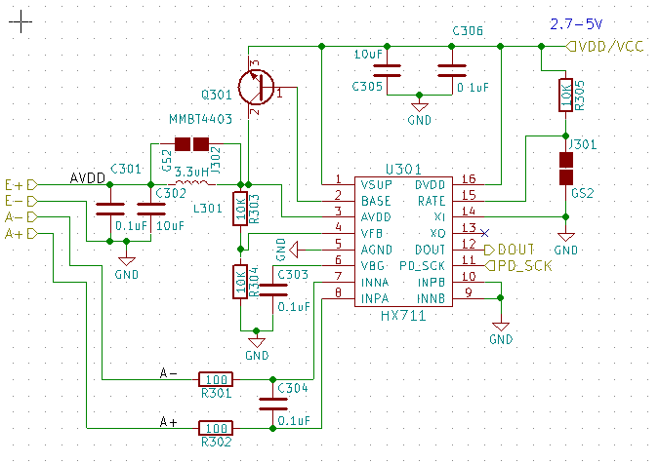
Load Cell Schematic

Slide 35
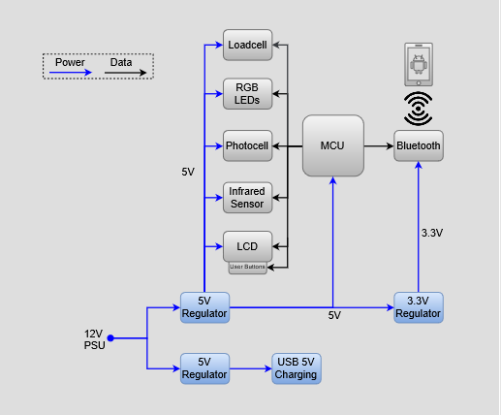
Power Delivery Subsystem

Slide 36
System Power Delivery PCB Topology
12V IN
5V OUT
3.3V OUT

Slide 37
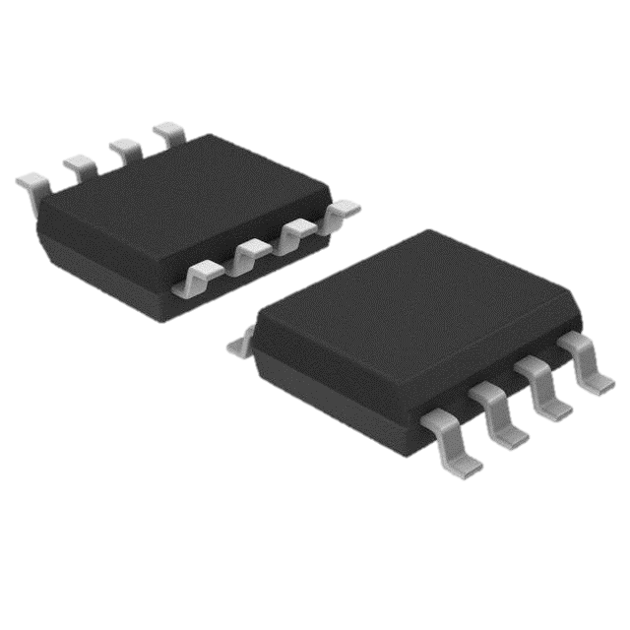
System Power Delivery
PCB Input Voltage 12 V
In-board Regulators
Two 5V Switching (Buck) Step-Down 3A
TI’s TPS5632 IC
One 3.3V LDO 300mA
TI’s LP2985 IC
PCB features thicker power line traces 40mils (low impedance)
PCB features reverse voltage prevention for 12V (series diode)
USB 5V OUT
Current Monitoring Sub-Circuit

Slide 38
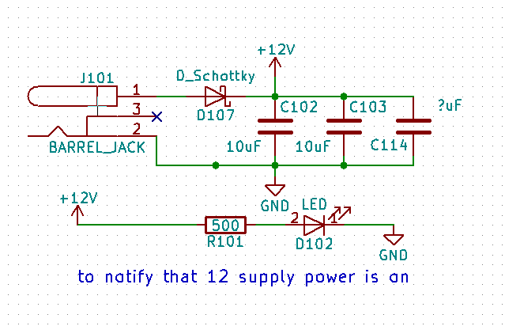
System Power Delivery Schematic
12 V Input
5V Out
3.3V Out

Slide 39
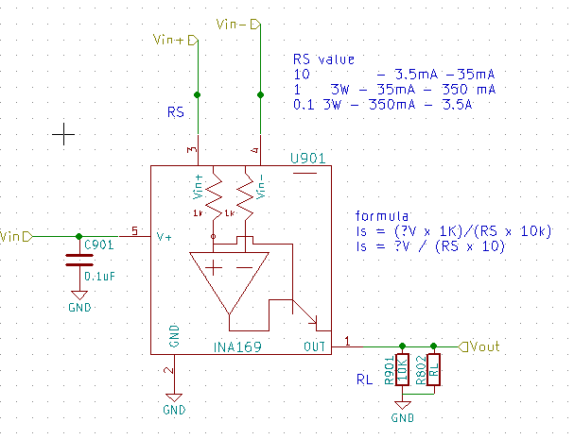
Current Monitoring Schematic
Uses a shunt resistor (low impedance with high power rating)
Op-amp uses the differential voltages of both sides of the resistor and outputs a analog signal
With the formula provided in the schematic we can derive the current from the output of the regulators

Slide 40
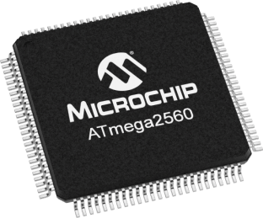
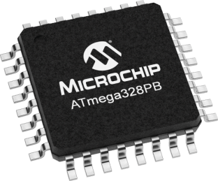
MCU Component Selection
Using the new Microchip 328PB microcontroller
Prototyped with Atmel ATmega 2560
$15 v $1
ISP v USB
Less pins to solder
MCU (ATmega Series) | 328-P | 328-PB | 2560
Analog Pins | 6 | 8 | 8
Digital Pins | 14 | 18 | 50
UART | 1 | 2 | 4
TD

Slide 41
Programmer's Tools / Circuit Debugging
PCB has numerous markers such as polarity on 12V
Several status LEDs
Manual switch for TX / RX
Current monitors for 3.3V / 5V regulators
Spare pins for expansion / debugging
Spare pads for components
Included solder bridges in PCB

Slide 42
Mobile Application

Slide 43
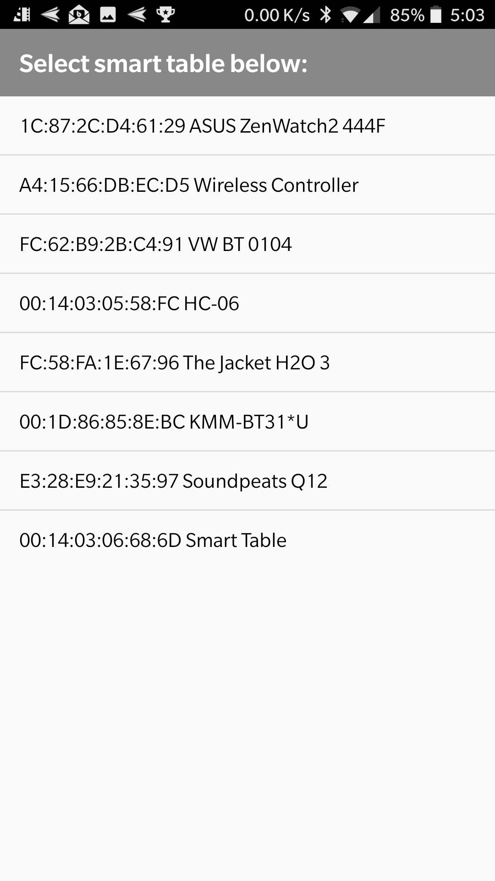
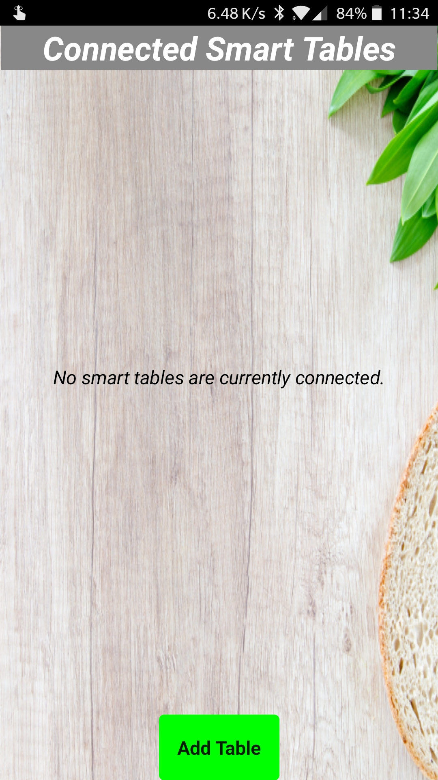
Mobile Application - Add Table
The mobile application is designed so that the server can receive notifications from the guests at the table
First a table must be added
Clicking on the Add Table button the server can connect to a new table
The Add Table screen shows a list of all smart tables in the area
Clicking a device will add the table to the home screen so the server can begin receiving notifications

Slide 44
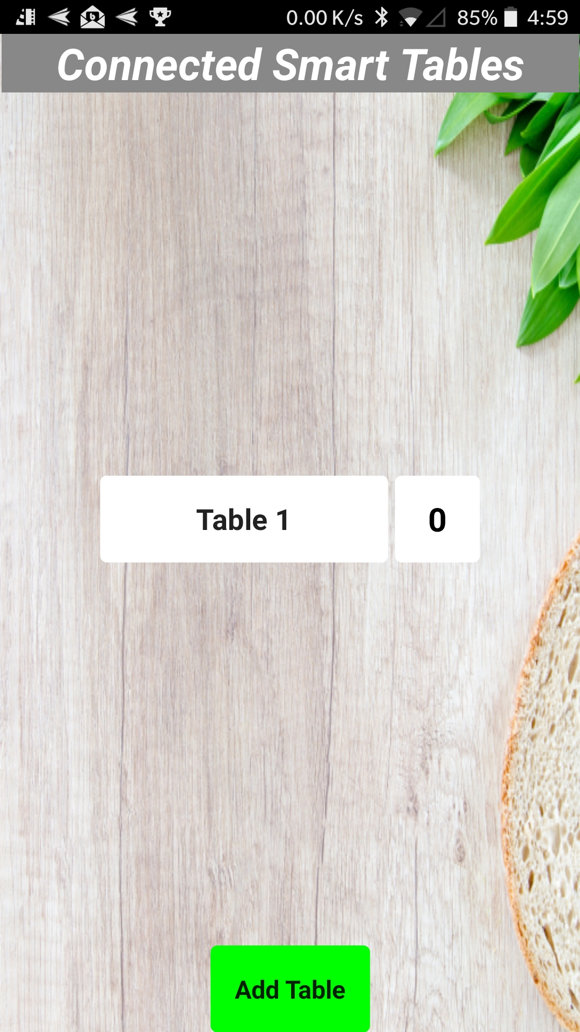
Mobile Application - Home Screen
Once a table is added it will be displayed on the home screen as a tile
The number of new notifications the table has will be displayed on the right of the table tile
The screenshot depicts what the server will see on the home screen of the application

Slide 45
Mobile Application - Table Notifications
Once inside the table screen the server can see a list of notifications
Some of these are automatically sent from the table, like the “Refill Needed”
Other notifications are directly sent from the guest, like when the guest clicks the request server button
By clicking the notification the server can dismiss it
The respond button will change the table from the red LED mode to the blue LED mode

Slide 46
Administrative Content
DC

Slide 47
Work Distribution
 | Chase | Chris | Dhaval | Mikey
PCB | P | S | T | S
Prototype |  | S | S | P
Main Logic |  | S | S | P
Ambient/Motion | S |  | P | S
UI |  | P | T | S
Bluetooth | S | P |  | S
Signal Lighting | T | S | S | P
Smart Beverage | P | S | S | S
Touch | P |  | S | S
Mobile App |  | P | S
Admin Work | T | S | P | S
P = Primary S = Secondary T = Tertiary

Slide 48
Budget
Development Boards | $50
Electronic Components (Mouser) | $150
Prototype (Sensors, LEDs, Buttons) | $105
PCB (JLCPCB) | $40
Box Construction | $65
Total | ~$410
Mouser components include resistors, photodiodes, LEDs, capacitors, Op-amps, and MCU
Prototype components include IR sensors, photocell, loadcell, smart LEDs, capacitive buttons, and the LCD

Slide 49
Demo

